Slide 1


Slide 2

Intelligence braking system
Name | Register number
V . Sreenivasulu | 99220041409
T . Santhosh kumar reddy | 99220041391
S . Praneeth gowd | 99220041376
Y . Gopi krishna | 99220041596
D . Ganesh | 99220041168

Slide 3
OUTLINE
INTRODUCTION
OBJECTIVE OF PROJECT
COMPONENTS
WORKING FUNCTION
SPECIFICATIONS
APPLICATIONS
LIMITATIONS
CONCLUSION
FUTURE SCOPE

Slide 4
INTRODUCTION:
The intelligent braking system is the next step to automation
What is braking?
Safety
The intelligent braking is an intelligent security technology to enhance the stability of vehicle braking and driving safety.

Slide 5
OBJECTIVE OF PROJECT :
Our goal is to create a control system that is based on the IBS, an intelligent electronic-controlled automotive braking system.
By using this system, we can avert many accidents and also many lives can be saved.
To develop a safety vehicle braking system using ultrasonic sensor with less human attention to the driving.
The primary objective of car accident severity prediction is to anticipate and classify the potential severity of car accidents based on various factors and data inputs.

Slide 6
FACTORS:
Resource allocation.
Emergency response.
Traffic management.
Insurance claims.
Public safety.
Policy and planning.
Research.
Data – driven decision making.

Slide 7
LITEATURE REVIEW:
The prediction of car accident severity has garnered significant attention in recent years due to its potential to enhance road safety and emergency response efforts. In this literature review, we explore key studies and methodologies .
Historical Approaches to Accident Severity Prediction.
Data-Driven Approaches.
Feature Engineering and Selection.
Real-Time Prediction and GIS Integration.
Hybrid Models.
Challenges and Future Directions.
In conclusion, the literature on car accident severity prediction reflects a transition from historical, expert-driven approaches to data-driven, machine learning-based methods.

Slide 8
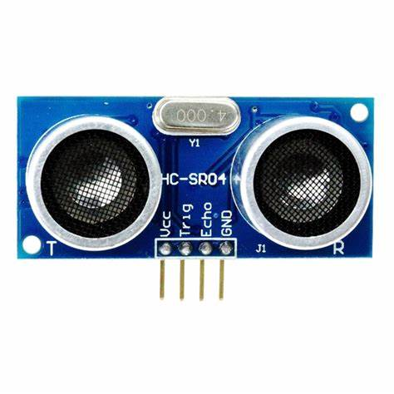
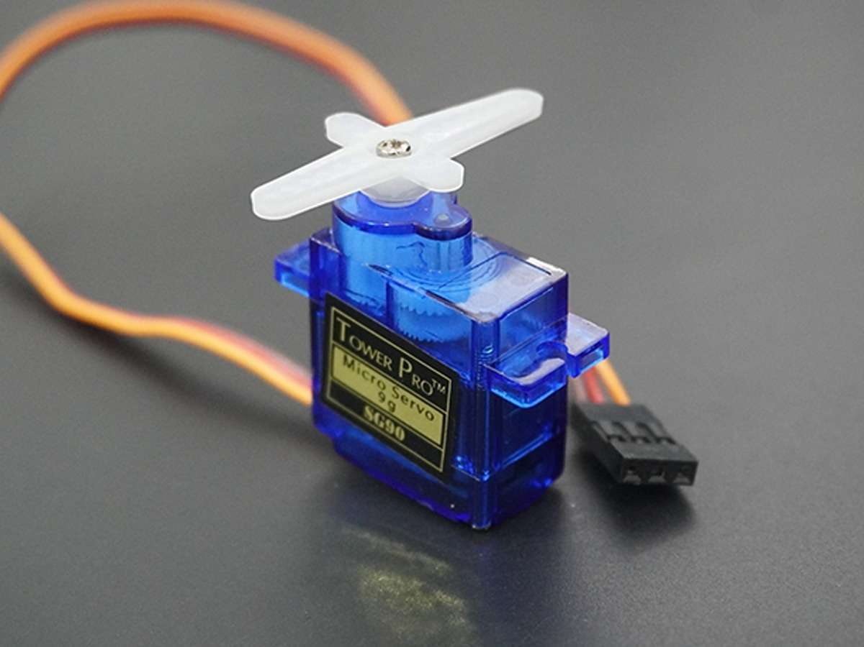
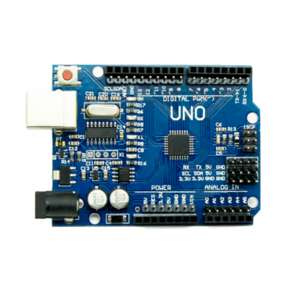
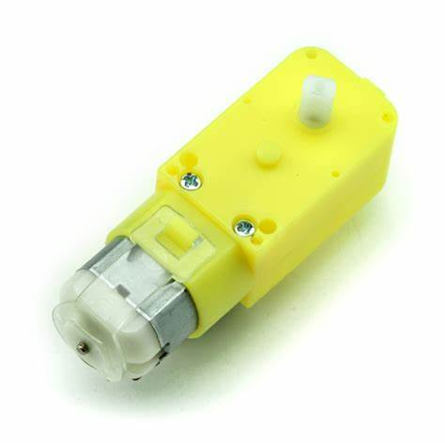
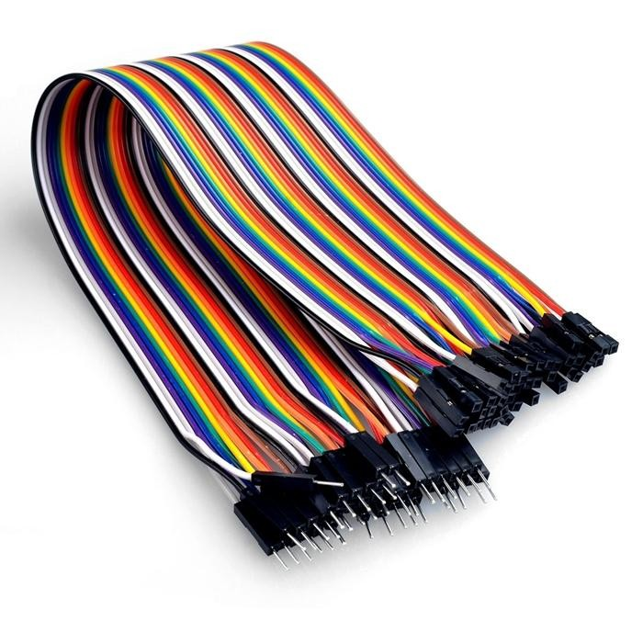
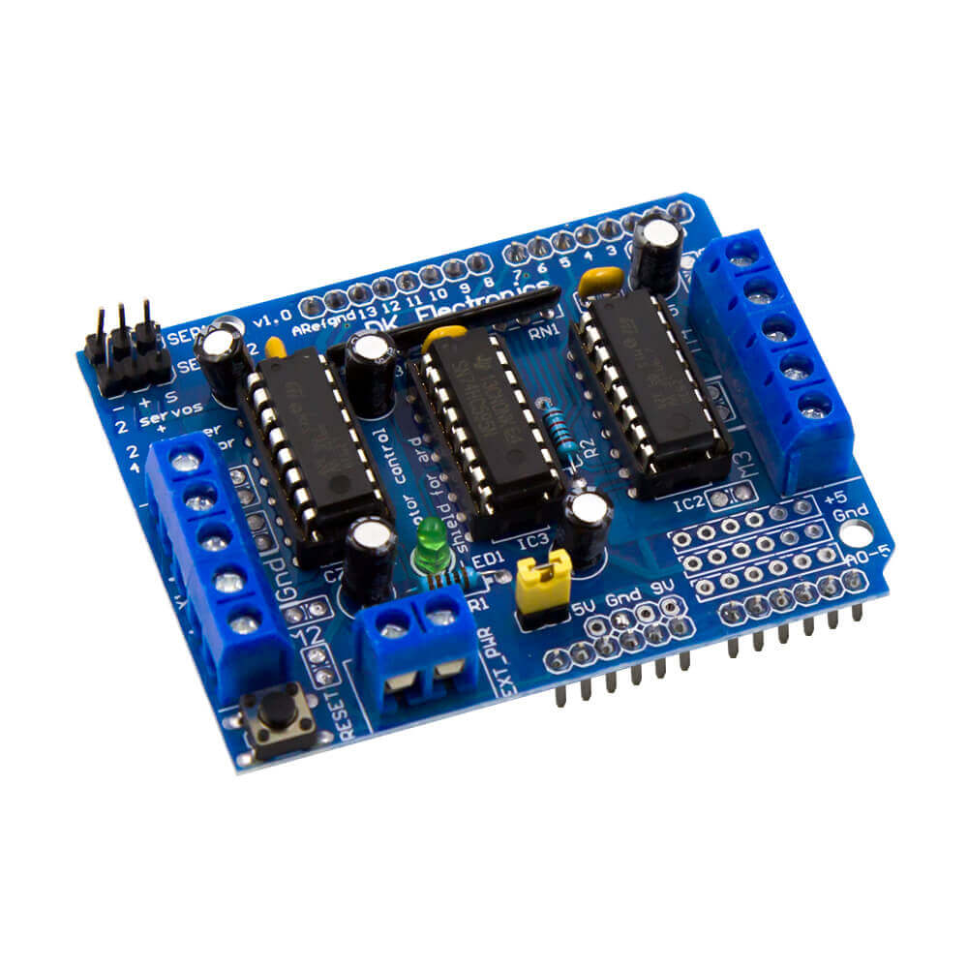
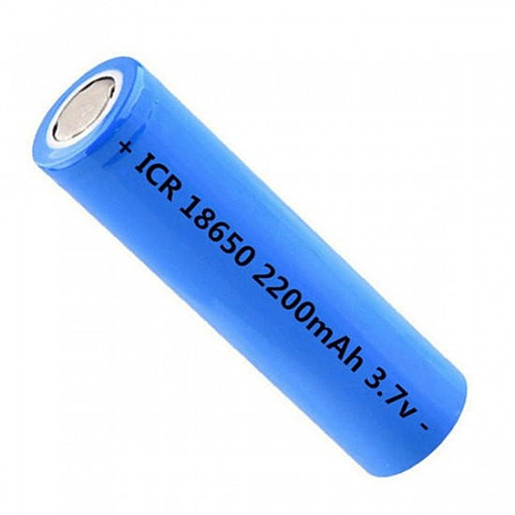
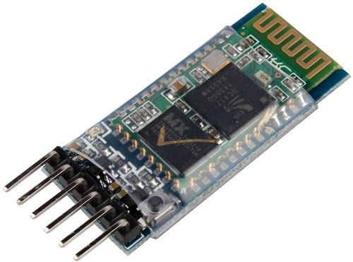
COMPONENTS:
GEAR MOTOR
ULTRASONIC SENSOR
ARDUINO UNO R3
SERVO MOTOR
L29 3D MOTOR DRIVER
JUMPER WIRES
LI-ION BATTERY
Bluetooth module HC 05

Slide 9
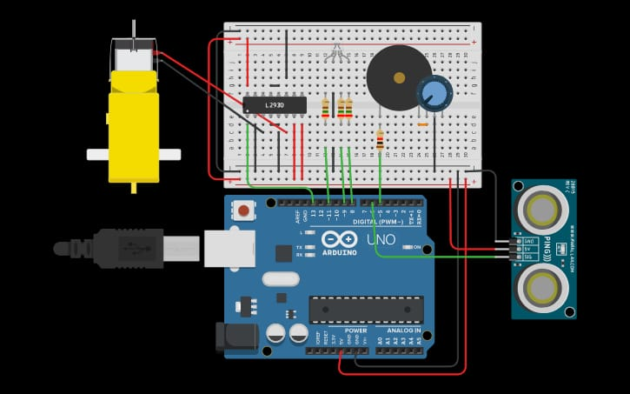

Slide 10
WORKING FUNCTION:
VEHICLE START
ULTRASONIC SENSOR
NO
OBSTACLE DETECTED
NO
SENSOR RECEVIER
BRAKING CIRCUIT
VEHICLE BRAKE

Slide 11
SPECIFICATIONS:
IBS ultrasonic sensor signal range is 100 to 160cm.
Resolution is 12 inches.
Signal output is 0-5V.
Excitation voltage is 12V.

Slide 12
APPLICATIONS:
controlling automobiles.
Automated guided vehicles in industries.
Production lines.
LIMITATIONS
Obstacle and vehicle braking is too small.
Initially high cost.

Slide 13
CONCLUSION:
Fabrication of automatic braking system.
Sensing of obstacles.
Knowledge and working of IBS.
Maximise safety
This system can be having bigger market space and a competitive edge in the market

Slide 14
FUTURE SCOPE:
This is the new function in this prototype that could be possibly used for all the vehicles.
It can be further used for large type of heavy vehicles.
We can surely get the information about the obstacle detection sense zones according to vehicle condition and it is very use full to public sector and users.

Slide 15


